Slide 1
Analysis of Offensive and Defensive Value in NBA Playoff Qualification
Additional Analysis of Positional Value

Slide 2
Do NBA teams prioritize offense or defense?
Is offensive or defense more valuable for team success?
What positions contribute most to offense and defense?

Slide 3
Data
Player data from 1982-2017
Offensive Box Plus Minus (OBPM), Defensive Box Plus Minus (DBPM), Offensive Win Shares (OWS), Defensive Win Shares (DWS)
Team record and playoff result from 1982-2017
Raw player data available here
Raw team data available here
Notes:
Explain what bpm and ws are

Slide 4
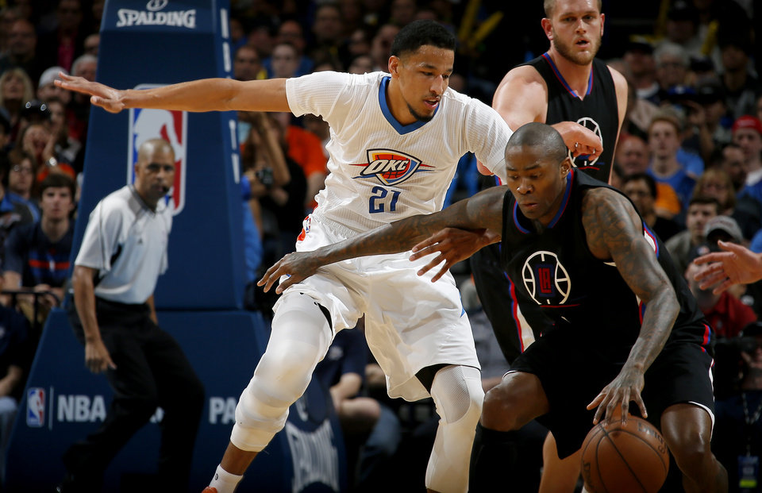
Do NBA teams prioritize offense or defense?
Andre Roberson: career -1.53 OBPM, +1.85 DBPM
Jamal Crawford: career +1.26 OBPM, -2.49 DBPM
Who do you start?

Slide 5
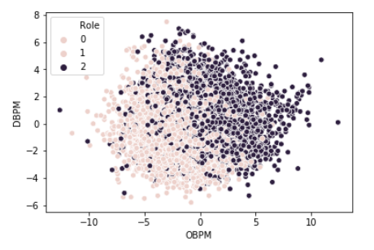
Starters on average had an OBPM 2 points higher than reserves
Starters on average had a DBPM 0.6-0.7 points higher than reserves
Notes:
Starters were categorized as 2, started more than 50% of games
Reserves were categorized as 1, played in more than 35% of games
Players who played less than 35% of games were excluded because their small sample size tended to skew the OBPM and DBPM statistics
Eg max OBPM included is 12.4, one player played 1 minute in the season and recorded an OBPM of 47.8
Specifically say “ran a t-test, statistically significant”

Slide 6
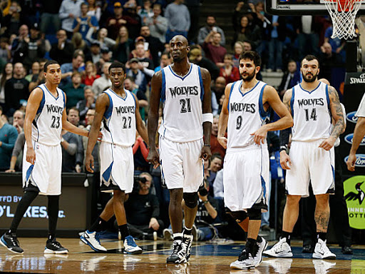
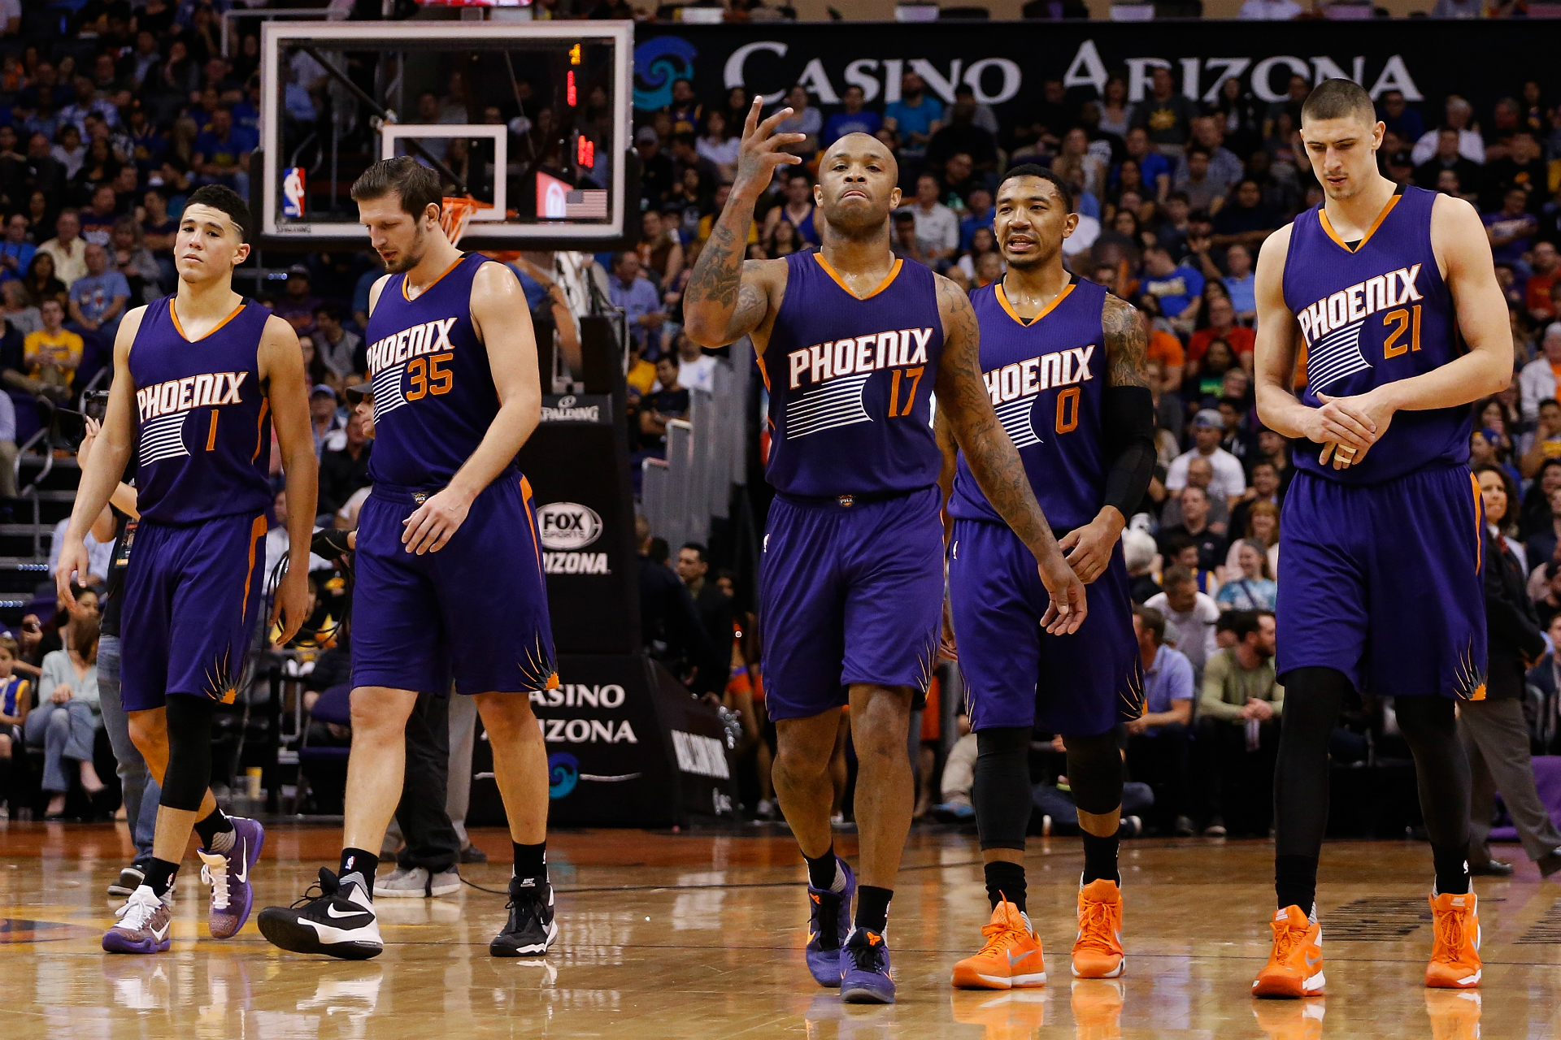
Is offensive or defense more valuable for team success?
2015 Minnesota Timberwolves starters vs reserves: +0.02 OBPM, +1.9 DBPM
WHO WINS?
2017 Phoenix Suns starters vs reserves: +2.1 OBPM, -0.04 DBPM

Slide 7
Starters versus Reserves
OBPM Difference
DBPM Difference
Difference between the average difference of the players OBPM/DBPM and the team average OBPM/DBPM for starters and reserves respectively
Why?
Do they prioritize playing offensive or defensive players more?

Slide 8
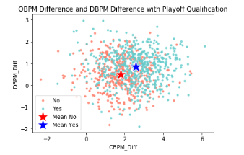
Playoff teams had an OBPM difference 0.6-0.9 points higher than non-playoff teams
Playoff teams had a DBPM difference 0.2-0.4 points higher than non-playoff teams
Notes:
Specifically say “ran a t-test, statistically significant”
Plot mean of yes and no

Slide 9
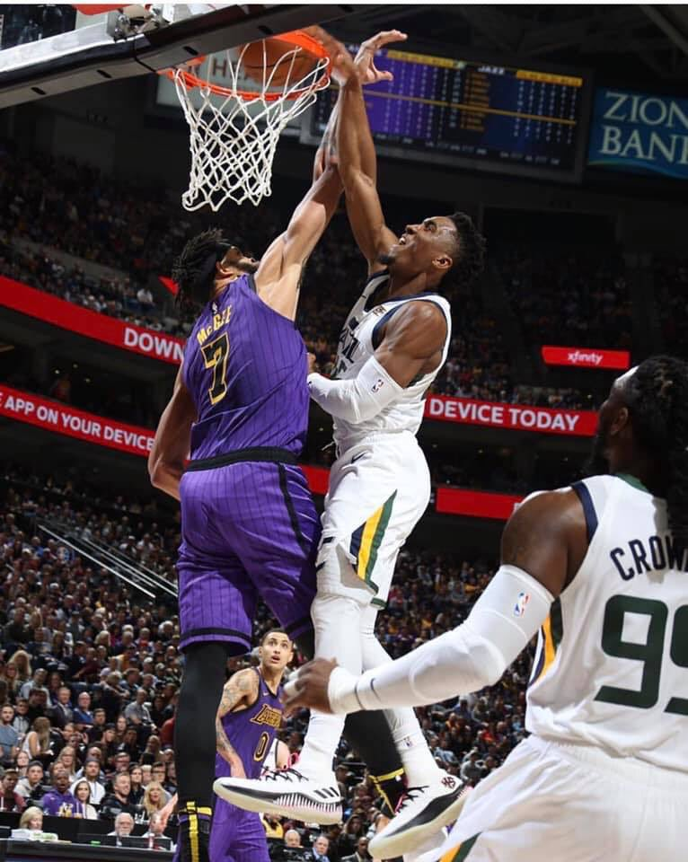
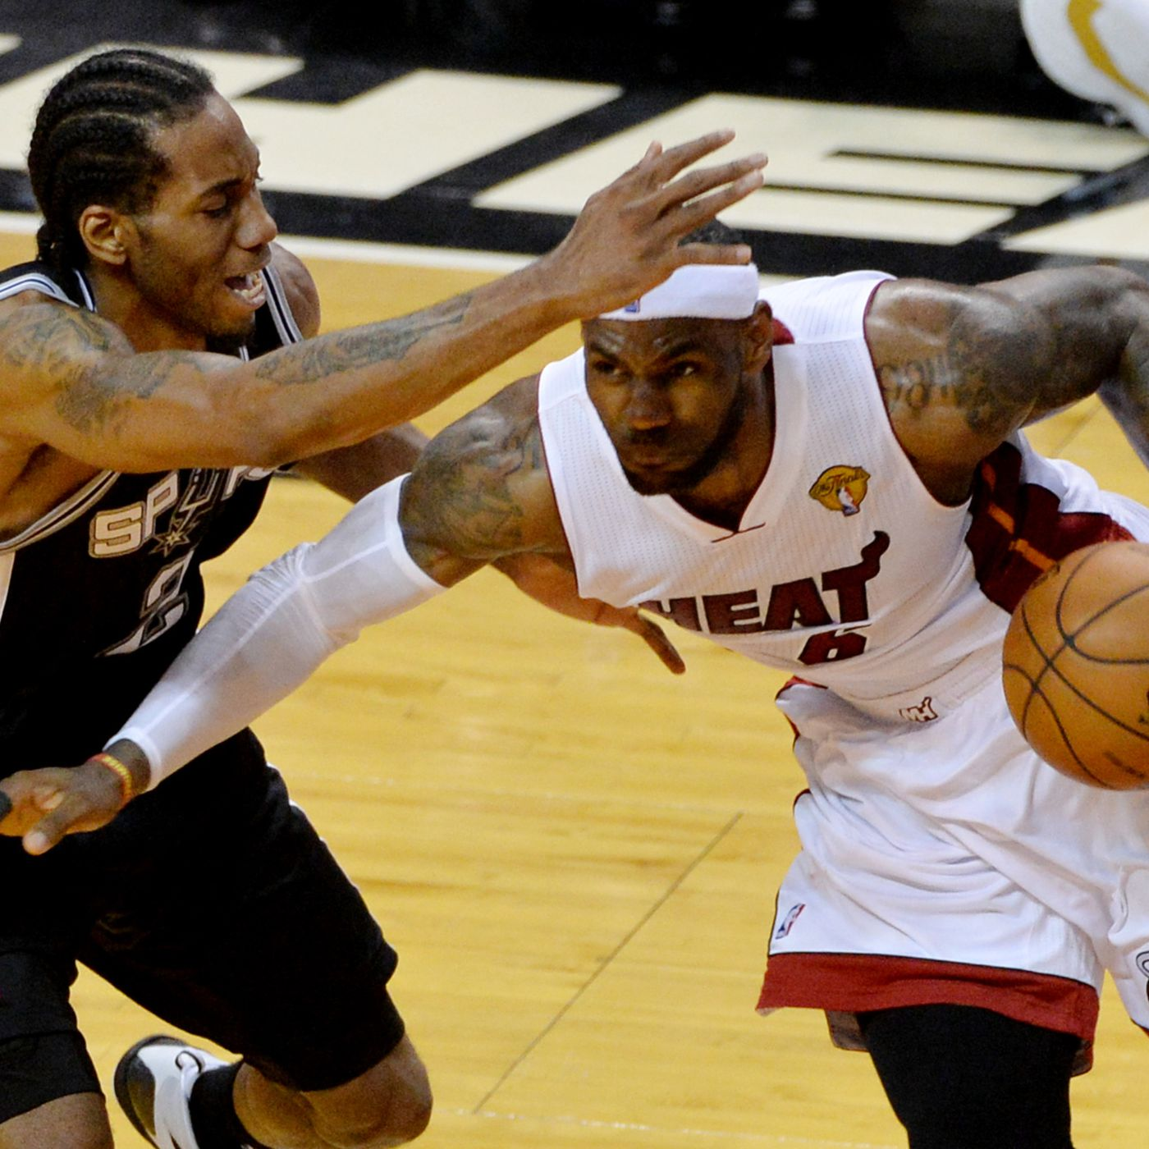
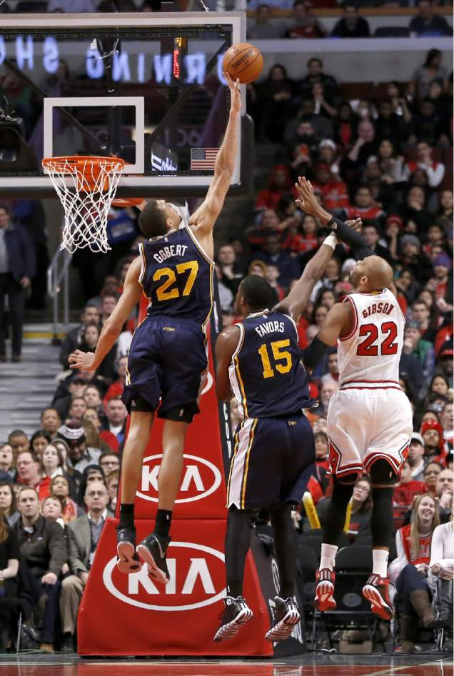
What positions contribute most to offense and defense?
PG?
SF?
C?
Notes:
This is why it matters

Slide 10
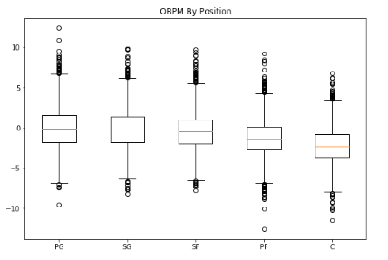

Slide 11
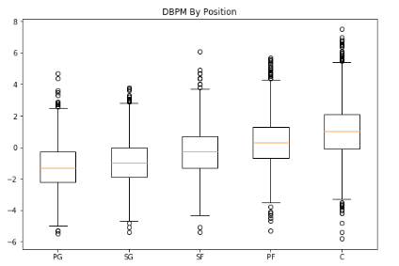

Slide 12
QUESTIONS?

Slide 13
THANK YOU!

